Slide 1


SP25-BL-INFO I590
Data Visualization
Final Project Presentation
Analyzing U.S. Immigration and H-1B Visa Trends (2020-2024)
Presentation By
Kishore Kumar Ramkumar (kramkum@iu.edu)
Mohammed Fahad Shahul Hameed (moshahul@iu.edu)
Ramcharan Suresh
(rasuresh@iu.edu)
Santhosh Kumaar Rajan
(rajansa@iu.edu)
Mouryan Jayasankar
(mjayasan@iu.edu)

Slide 2
Introduction
  Our project leverages H1B LCA disclosure data from 2020 to 2024 which has been pre processed and cleaned to explore wage practices and employer behaviors in the H1B visa program.
  By examining offered wages, prevailing wages, and additional employer attributes, we aim to uncover trends and patterns that reveal how employers position themselves when hiring H1B workers.
  This analysis not only deepens our understanding of wage compliance but also informs discussions on fair labor practices and regulatory enforcement in a highly competitive market.

Slide 3
Motivation
  Ensuring that foreign workers receive wages that are competitive with local market standards is critical for economic fairness and social justice.
  Ensuring immigrant workers are compensated fairly is critical for economic equity
  Wage discrepancies can lead to exploitation and create imbalances in the labor market, affecting both the quality of life for immigrant workers and the broader economic landscape.
  Data-driven insights help expose wage discrepancies and support policy development.
  Our project connects these real-world issues to the power of data visualization by transforming complex datasets into clear, actionable insights. By doing so, we aim to support policymakers, industry leaders, and the public in addressing labor fairness and compliance challenges.

Slide 4
Questions and Goals
Our work is driven by several key questions:
  How do offered wages compare with prevailing wages across different occupations and regions?
  Do employers that heavily rely on H1B workers display distinct wage practices compared to those that do not?
  What geographic and temporal patterns can be discerned in H1B wage offers?
  Does the involvement of legal representation influence wage levels?
  Our goal is to create interactive, insightful visualizations that not only answer these questions but also provide actionable intelligence for improving labor standards and informing policy.

Slide 5
Research Questions
  Our project leverages H1B LCA disclosure data from 2020 to 2024 which has been pre processed and cleaned to explore wage practices and employer behaviors in the H1B visa program.
  By examining offered wages, prevailing wages, and additional employer attributes, we aim to uncover trends and patterns that reveal how employers position themselves when hiring H1B workers.
  This analysis not only deepens our understanding of wage compliance but also informs discussions on fair labor practices and regulatory enforcement in a highly competitive market.

Slide 6
Background & Existing Work
Prior research and reports provide valuable insights into H-1B visa approvals, salary trends, and employer participation, but they have limitations:
🔹 Static Reports: Existing government reports (USCIS, DHS) provide tabular datasets but lack interactive and comparative visualizations for deeper insights.
🔹 Generalized Analysis: Most studies analyze immigration at a macro level, but few focus on industry-specific, salary-based, and employer-based trends in H-1B applications.
🔹 Lack of Predictive Insights: Many reports track historical trends but do not forecast future H-1B approval trends or identify policy-driven shifts.

Slide 7
Literature Survey
Aspect | Existing Work (Limitations) | Proposed Work (Improvements)
H-1B Data Analysis | Most studies provide static reports with raw H-1B petition data, lacking interactive analysis. | We will use interactive visualizations to explore approval trends, employer participation, and salary distributions.
Visualization Techniques | Simple bar charts or tables in reports, making it hard to analyze trends dynamically. | Utilize time-series analysis, heatmaps, choropleth maps, and tree maps for deeper insights.
Employer & Industry Insights | Existing studies focus on macro-level trends, missing employer-specific and industry-specific insights. | Identify top H-1B sponsors, industry-wise approval rates, and salary variations across sectors.
Salary & Job Trends | Limited research on how salary influences H-1B approvals. | Analyze salary distributions across industries, compare certified vs. denied applications, and explore wage trends over time.
Geospatial Analysis | Country-wise H-1B approvals are often presented as static numbers rather than visual maps. | Choropleth & geospatial heatmaps to show which countries and U.S. states contribute most to H-1B applications.
Impact of Policy Changes | Studies highlight policy effects on H-1B approvals, but lack data-driven comparisons. | Compare approval rates before and after major immigration policy shifts to show direct impacts.
Comparative & Predictive Analysis | Existing research tracks historical trends but lacks forecasting. | Use predictive modeling and machine learning trends to estimate future H-1B visa trends.
Accessibility & User Interaction | Research papers and reports are not interactive, making it difficult for users to explore data. | Implement dashboard-style interactive visualizations that allow filtering by employer, salary, country, and year.

Slide 8
Proposed Work
Our project aims to provide data-driven insights into U.S. immigration and H-1B visa trends through interactive and comparative visualizations. We will analyze H-1B employer patterns, wage distributions, and immigration trends over time to understand the program’s impact on the workforce.
Key Objectives
✅ Analyze H-1B Visa Trends Over Time
  Track H-1B application & approval rates from past years.
  Identify policy-driven fluctuations in visa approvals.
✅ Employer & Industry-Specific Analysis
  Identify top H-1B sponsoring companies and industries.
  Compare approval vs. denial rates across industries.
✅ Salary & Job Market Insights
  Analyze salary distributions across job roles & industries.
  Compare wage trends for certified vs. denied applications.
✅ Country-Wise Immigration Patterns
  Identify top source countries for H-1B approvals.
  Compare immigration trends with employment-based approvals.

Slide 9
Datasets
Datasets | Source | Details
USCIS H-1B Employer Data Hub | https://www.uscis.gov/tools/reports-and-studies/h-1b-employer-data-hub | Employer-based H-1B petition approvals and denials
H-1B LCA Disclosure Data (2020-2024) | https://www.kaggle.com/datasets/zongaobian/h1b-lca-disclosure-data-2020-2024 | H-1B job applications and salaries
U.S. Immigration Trends Dataset | https://dr.lib.iastate.edu/server/api/core/bitstreams/f6654827-cf87-44e6-8553-bce39fe404d7/content | Overall U.S. immigration trends (employment-based & family-based visas)
H-1B Demographic Breakdown Data | https://www.uscis.gov/tools/reports-and-studies | Demographics of H-1B applicants by country and gender

Slide 10
Datasets
We are using the H1B LCA Disclosure dataset spanning 2020 to 2024, which contains 96 columns of data. This rich tabular dataset includes key fields such as:
  WAGE_RATE_OF_PAY and WAGE_UNIT_OF_PAY (numerical values indicating the offered wage),
  PREVAILING_WAGE and PW_UNIT_OF_PAY (numerical values representing the standard wage),
  JOB_TITLE, SOC_CODE, and SOC_TITLE (categorical fields for job categorization),
  WORKSITE_STATE and WORKSITE_CITY (geographic information),
  H1B_DEPENDENT and WILLFUL_VIOLATOR flags (binary/categorical indicators),
  AGENT_ATTORNEY_NAME and LAWFIRM_NAME (text fields identifying legal representation). The dataset’s diverse range of data types (numeric, categorical, and date fields) provides a comprehensive basis for our analysis.

Slide 11
Preliminary Exploration
Initial exploration reveals a wide distribution of wage rates and a variety of job titles and SOC codes across multiple geographic regions. We have identified variations in wage distributions that suggest differences in employer practices, as well as seasonal or policy-driven trends in filing volumes. This early insight confirms that our dataset is robust and well-suited for multi-dimensional analysis.
  Filtered for H-1B applications only
  Normalized wage values to annual salary
  Cleaned missing/incorrect data
  Focused on realistic salary ranges ($20,000–$500,000)
  Extracted year from received dates for temporal analysis

Slide 12
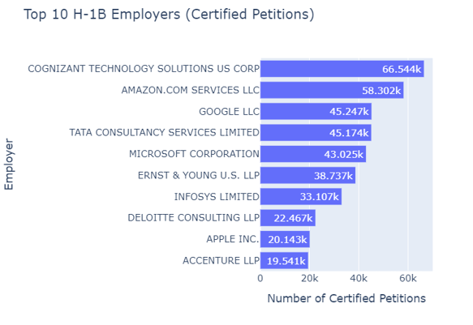
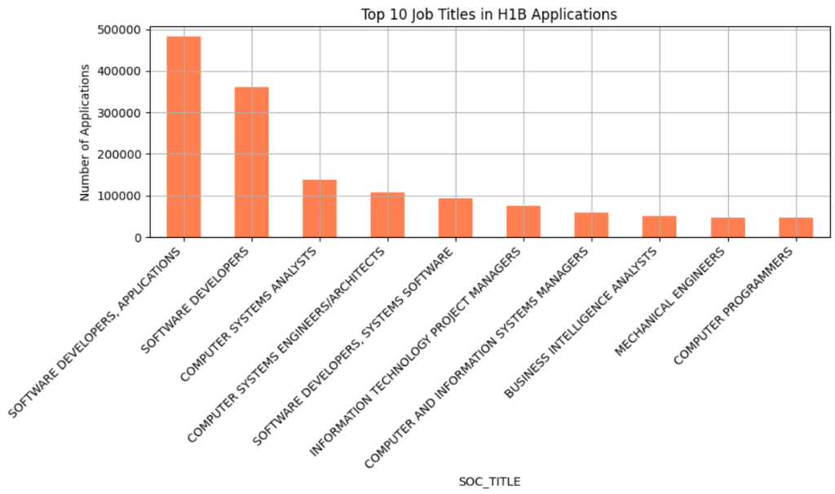
Visualizations
  Q1. Which job roles and industries dominate H-1B sponsorship?

Slide 13
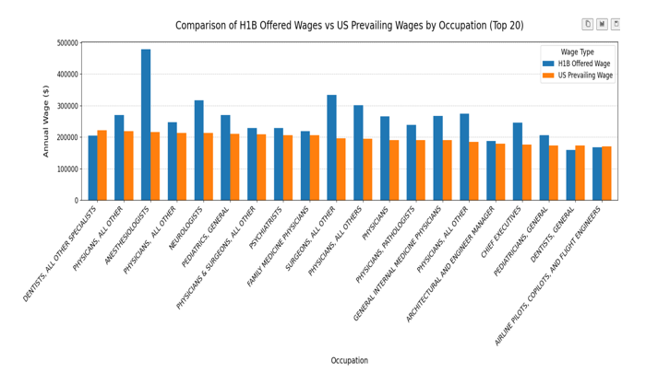
Visualizations
Q2. Are H-1B wages generally higher than prevailing wages across states and occupations?
H-1B Offered vs. Prevailing Wages by Occupation (Bar Chart)

Slide 14
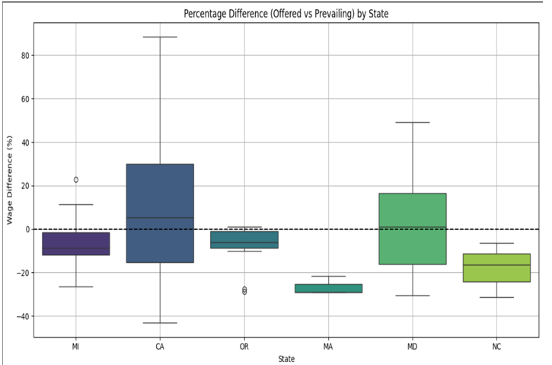
Visualizations
Q2. Are H-1B wages generally higher than prevailing wages across states and occupations?
  Percentage Wage Difference by State (Box Plot)

Slide 15
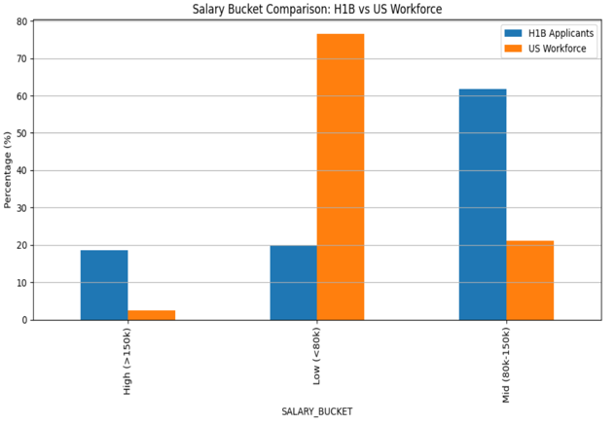
Visualizations
Q2. Are H-1B wages generally higher than prevailing wages across states and occupations?
  Salary Bucket Comparison (Bar Chart)

Slide 16
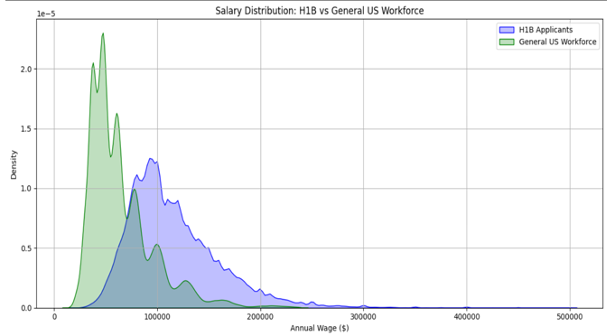
Visualizations
Q2. Are H-1B wages generally higher than prevailing wages across states and occupations?
  Salary Distribution – H-1B vs. US Workforce (Density Plot)

Slide 17
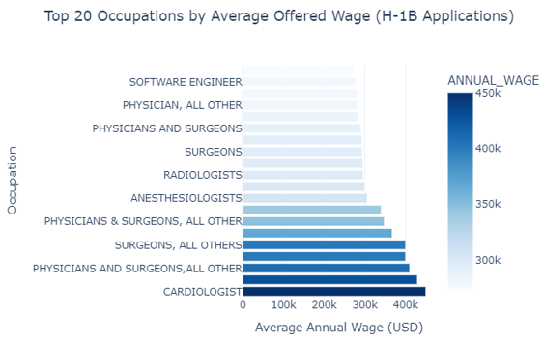
Visualizations
Q2. Are H-1B wages generally higher than prevailing wages across states and occupations?
  Top 20 Occupations by Average H-1B Wage (Bar Chart)

Slide 18
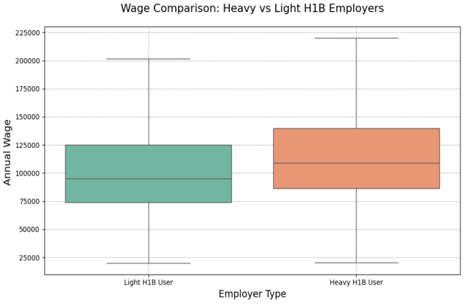
Visualizations
Q3. Do employers that heavily depend on H-1B workers display different wage behaviour than others?
  Wage Comparison – Heavy vs. Light H-1B Employers (Box Plot)

Slide 19
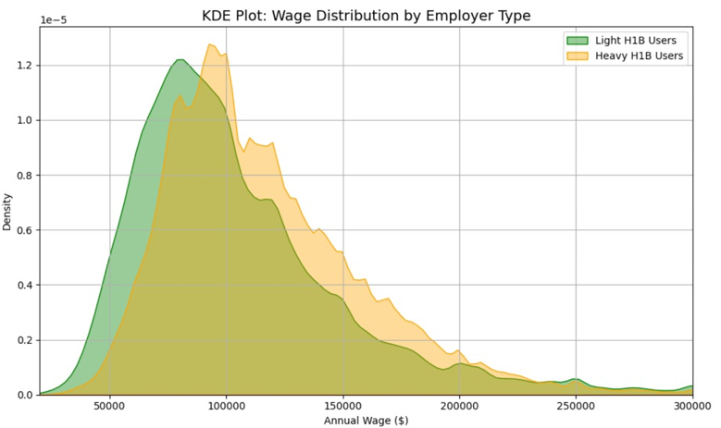
Visualizations
Q3. Do employers that heavily depend on H-1B workers display different wage behaviour than others?
  KDE Plot – Wage Distribution by Employer Type

Slide 20
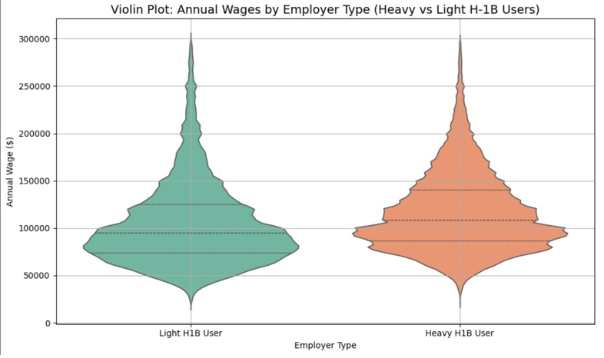
Visualizations
Q3. Do employers that heavily depend on H-1B workers display different wage behaviour than others?
  Violin Plot – Annual Wages by Employer Type

Slide 21
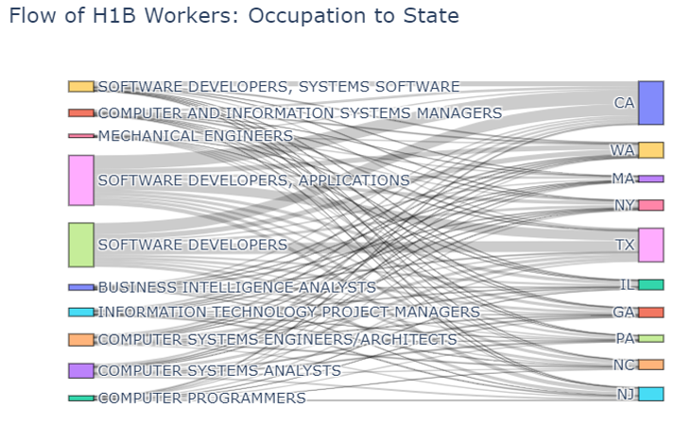
Visualizations
Q4. Which U.S. states serve as hotspots for specific occupations under the H-1B program?
  Flow of H-1B Workers – Occupation to State (Sankey Diagram)

Slide 22
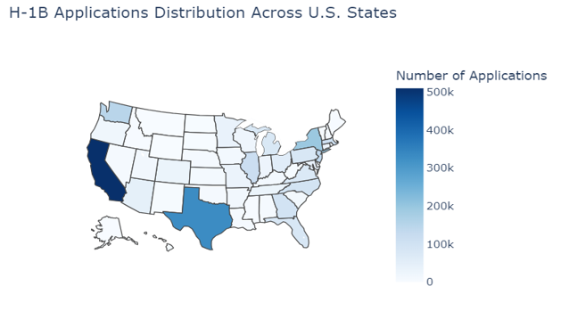
Visualizations
Q4. Which U.S. states serve as hotspots for specific occupations under the H-1B program?
  Choropleth Map – H-1B Applications Distribution Across States

Slide 23
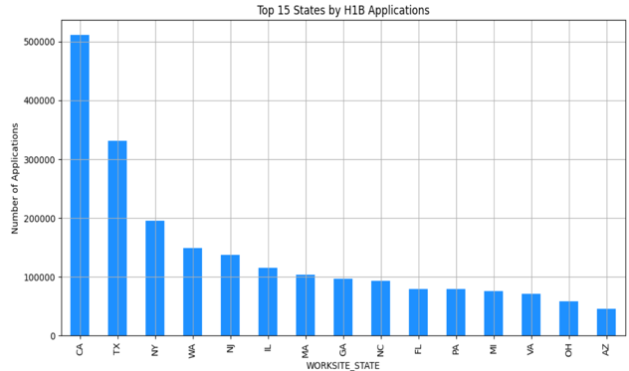
Visualizations
Q4. Which U.S. states serve as hotspots for specific occupations under the H-1B program?
  Top 15 States by H-1B Applications (Bar Chart)

Slide 24
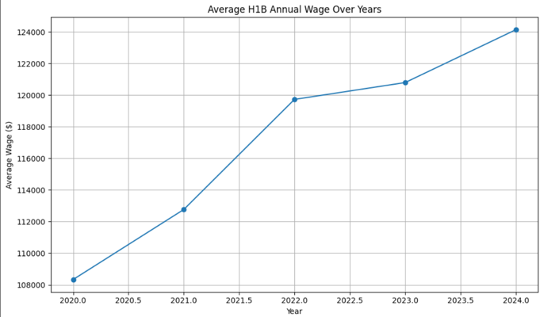
Visualizations
Q5. What geographic and temporal patterns can be discerned in H1B wage offers?
  Average H-1B Annual Wage Over Years (Line Chart)

Slide 25
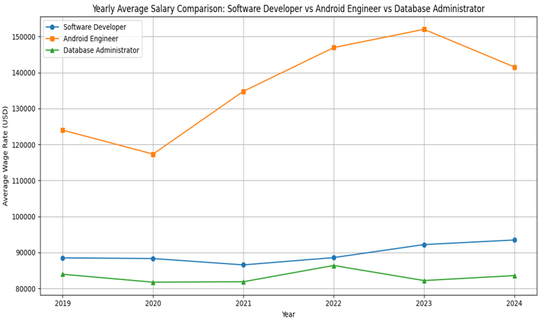
Visualizations
Q5. What geographic and temporal patterns can be discerned in H1B wage offers?
  Yearly Salary Comparison by Job Title (Line Chart)

Slide 26
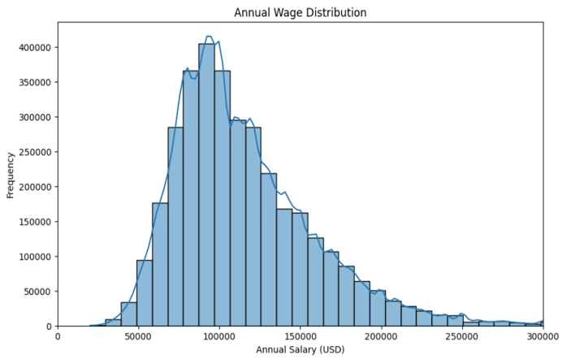
Visualizations
Q5. What geographic and temporal patterns can be discerned in H1B wage offers?
  Annual Wage Distribution (Histogram with KDE)

Slide 27
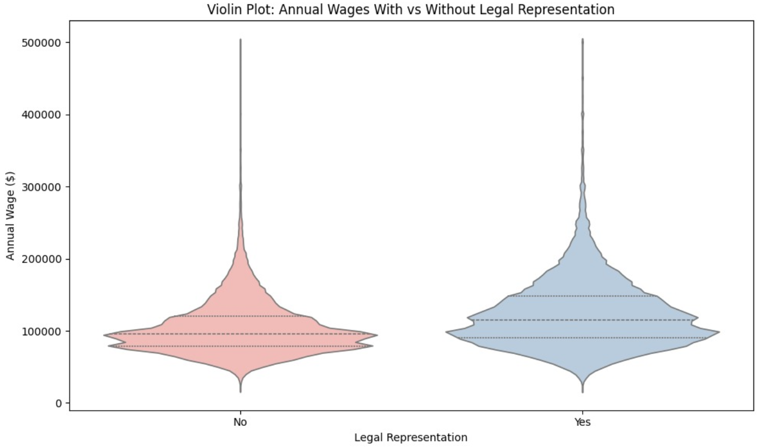
Visualizations
Q6. Does the involvement of legal representation influence wage levels?
  Violin Plot – Annual Wages With vs. Without Legal Representation

Slide 28
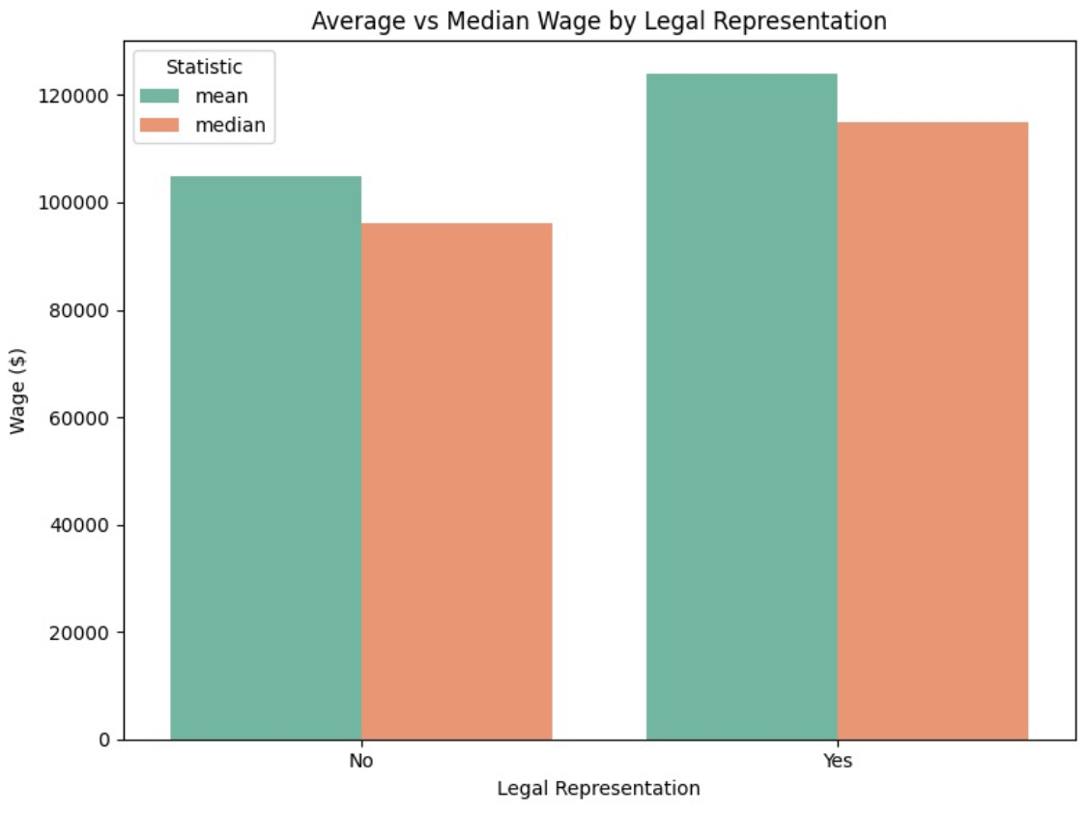
Visualizations
Q6. Does the involvement of legal representation influence wage levels?
  Mean vs. Median Wage by Legal Representation (Grouped Bar Chart)

Slide 29
References
  Yearbook of Immigration Statistics: https://ohss.dhs.gov/topics/immigration/yearbook
  USCIS H-1B Trend Data (2007-2017): https://www.uscis.gov/sites/default/files/document/data/h-1b-2007-2017-trend-tables.pdf
  H-1B Visa Cap Reach Dates History: https://redbus2us.com/h1b-visa-cap-reach-dates-history-graphs-uscis-data/
  Pew Research Center: https://www.pewresearch.org/short-reads/2024/09/27/key-findings-about-us-immigrants/
  Migration Policy Institute: https://www.migrationpolicy.org/programs/data-hub/charts/immigrant-population-over-time
  American Immigration Council. (2024) https://www.americanimmigrationcouncil.org/research/h1b-visa-program-fact-sheet

Slide 30
References
Congressional Research Service. (2020). https://sgp.fas.org/crs/misc/RL33977.pdf
Federal Register. (2024, December 18). https://www.federalregister.gov/documents/2024/12/18/2024-29354/modernizing-h-1b-requirements-providing-flexibility-in-the-f-1-program-and-program-improvements
Pew Research Center. (2024, September 27). https://www.pewresearch.org/short-reads/2024/09/27/key-findings-about-us-immigrants/
Seyfarth Shaw LLP. (2024). Keeping your ducks in H-1B row.https://www.seyfarth.com/news-insights/keeping-your-ducks-in-h-1b-row-compliance-strategies-for-employers.html
U.S. Department of Labor, Wage and Hour Division. (2024). H-1B program. https://www.dol.gov/agencies/whd/immigration/h1b
U.S. Citizenship and Immigration Services. (2024).https://www.uscis.gov/tools/reports-and-studies/h-1b-employer-data-hub

Slide 31
Presentation Video Link
YouTube Video Link - https://www.youtube.com/watch?v=35JZWMPVXPI&feature=youtu.be

Slide 32
THANK YOU

